Slide 1
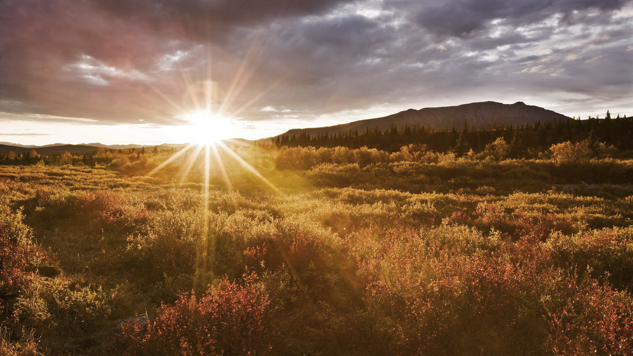
How Great is Our God

Slide 2
The splendor of a King,
clothed in majesty Let all the earth rejoice All the earth rejoice
尊贵荣耀君王
在全地之上
愿万民都欢欣
全地都欢欣

Slide 3
He wraps himself in Light,
and darkness tries to hide And trembles at His voice Trembles at His voice
主你满有荣光
黑暗都躲藏
万民高声唱
齐来高声唱

Slide 4
How great is our God, sing with me
How great is our God, and all will see
How great, how great is our God
我神 真伟大
歌颂你圣名真伟大
全地都看见
我神真伟大

Slide 5
Age to age He stands And time is in His hands Beginning and the end Beginning and the end
昔在永在君王
从今直到永远
你从不曾改变
永存在天地间

Slide 6
The Godhead Three in One Father Spirit Son The Lion and the Lamb The Lion and the Lamb
你是三一真神
父子与圣灵
真神的羔羊
全能神羔羊

Slide 7
How great is our God, sing with me
How great is our God, and all will see
How great, how great is our God
我神 真伟大
歌颂你圣名真伟大
全地都看见
我神真伟大

Slide 8
The splendor of a King,
clothed in majesty Let all the earth rejoice All the earth rejoice
尊贵荣耀君王
在全地之上
愿万民都欢欣
全地都欢欣

Slide 9
He wraps himself in Light,
and darkness tries to hide And trembles at His voice Trembles at His voice
主你满有荣光
黑暗都躲藏
万民高声唱
齐来高声唱

Slide 10
How great is our God, sing with me
How great is our God, and all will see
How great, how great is our God
我神 真伟大
歌颂你圣名真伟大
全地都看见
我神真伟大

Slide 11
Age to age He stands And time is in His hands Beginning and the end Beginning and the end
昔在永在君王
从今直到永远
你从不曾改变
永存在天地间

Slide 12
The Godhead Three in One Father Spirit Son The Lion and the Lamb The Lion and the Lamb
你是三一真神
父子与圣灵
真神的羔羊
全能神羔羊

Slide 13
How great is our God, sing with me
How great is our God, and all will see
How great, how great is our God
我神 真伟大
歌颂你圣名真伟大
全地都看见
我神真伟大

Slide 14
Name above all names
Worthy of our praise
My heart will sing
How great is our God
你至圣尊名
配受大赞美
全心歌颂
我神真伟大

Slide 15
Name above all names
Worthy of our praise
My heart will sing
How great is our God
你至圣尊名
配受大赞美
全心歌颂
我神真伟大

Slide 16
How great is our God, sing with me
How great is our God, and all will see
How great, how great is our God
我神 真伟大
歌颂你圣名真伟大
全地都看见
我神真伟大

